Slide 1

Smart Study Planner for Students
Presented By:
SARATHKUMAR DUNNAPAPAGARI
SIR CR REDDY COOLEGE OF ENGINEERING
INFORMATION TECHNOLOGY

Slide 2
OUTLINE
Problem Statement
System Development Approach (Technology Used)
Algorithm & Deployment
Result
Conclusion
Future Scope
References

Slide 3

Problem Statement
Students often struggle to manage their study schedules, tasks, and priorities.
Existing planners lack integration of reminders, progress tracking, and a clear timeline view.
There is a need for an easy-to-use, smart study planner for students.

Slide 4
System Approach
Frontend Technologies:
HTML5 – Structure of the webpage
CSS3 – Styling and responsive layouts
JavaScript – Dynamic interactivity (cart, filtering, total calculation)
Design Approach:
Clean and user-friendly interface
Mobile-responsive design
Modular separation of HTML, CSS, and JS files

Slide 5
Algorithm & Deployment
Task Management: Create, edit, and delete tasks with priority, due dates, reminders.
KPI Computation: Calculate total tasks, completed, overdue, and progress.
Timeline Rendering: Display tasks across a 7-day grid by priority.
Notifications: Show reminders at due time using browser notifications.
Deployment: Host using GitHub Pages

Slide 6
Result
Github link
https://github.com/sarathdunna/smartstudyplannerforstudents.git
Deployment link
https://sarathdunna.github.io/smartstudyplannerforstudents/

Slide 7
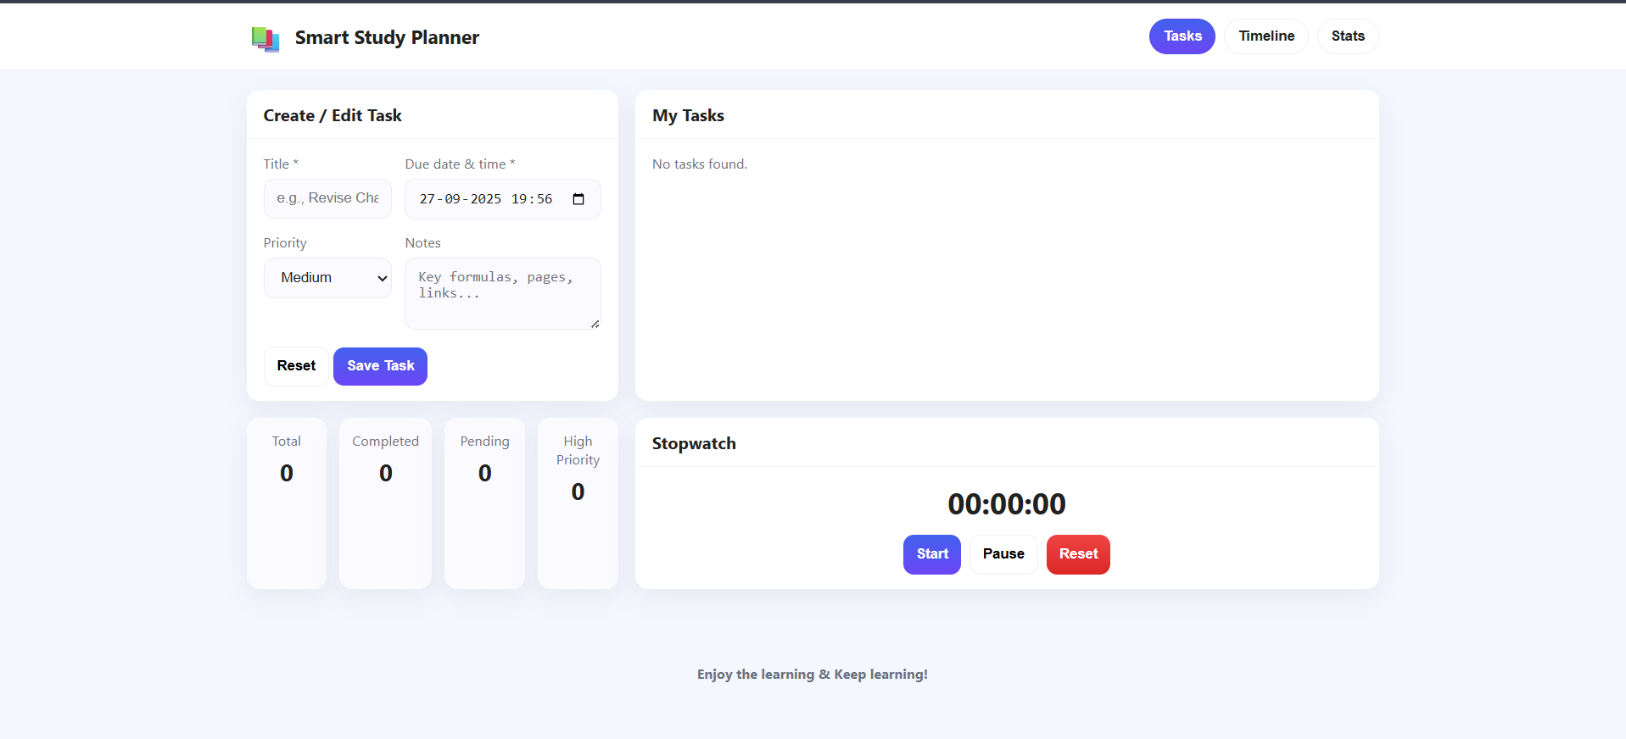

Slide 8
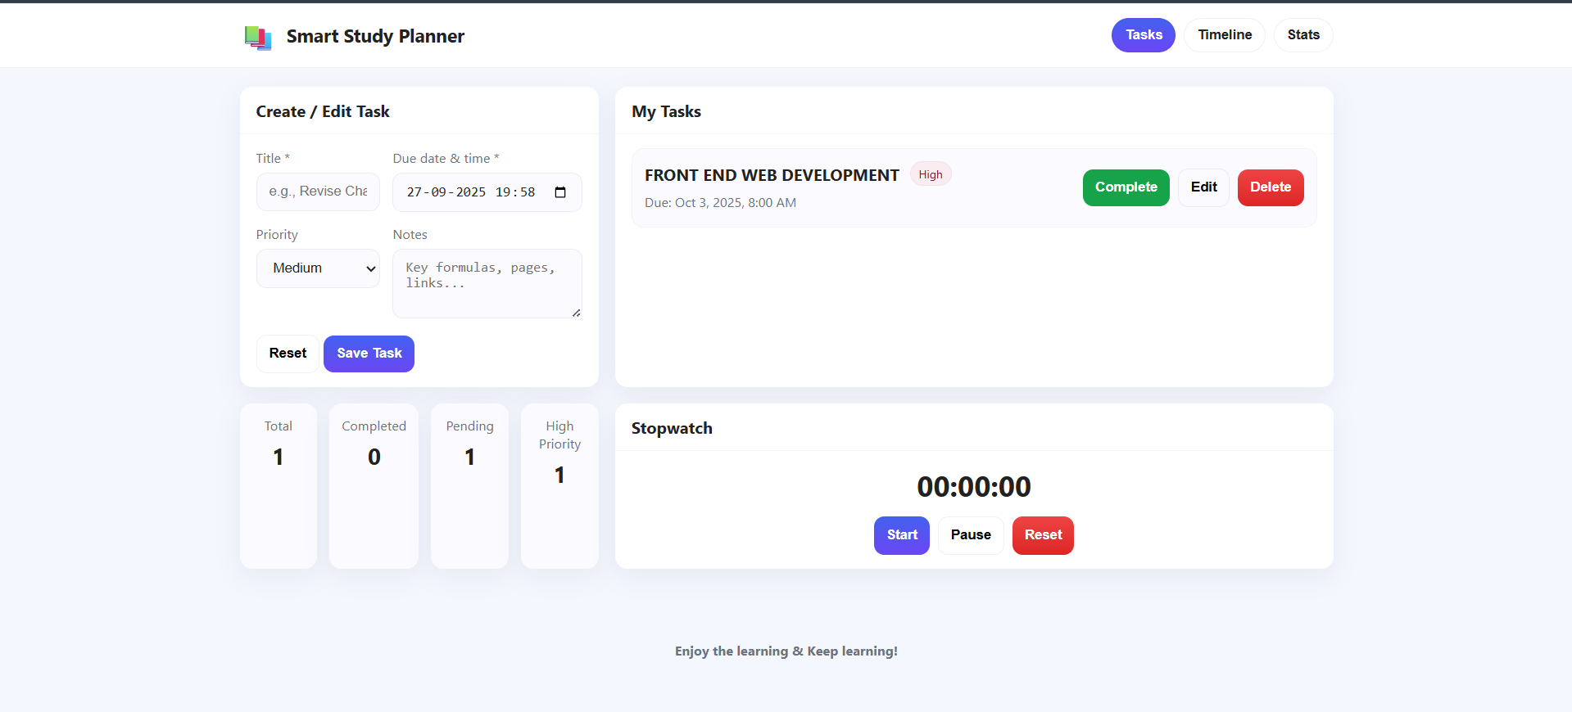

Slide 9
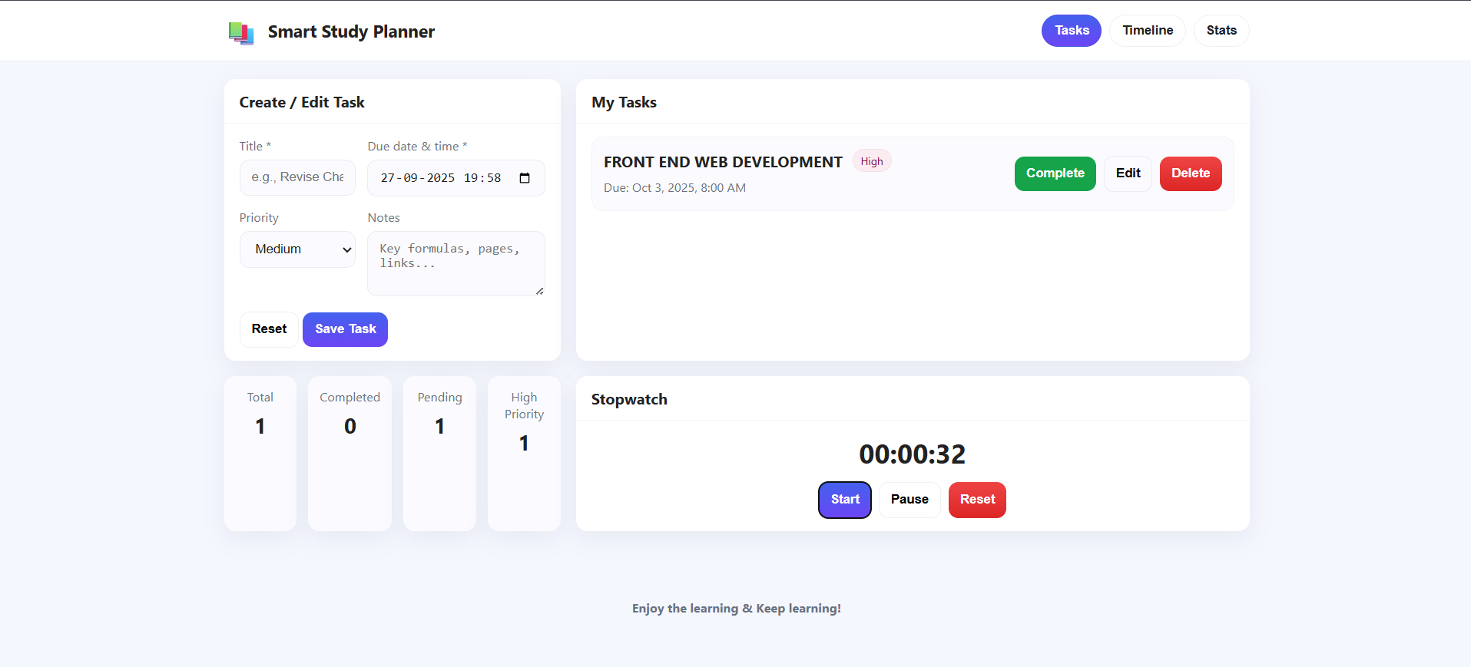

Slide 10
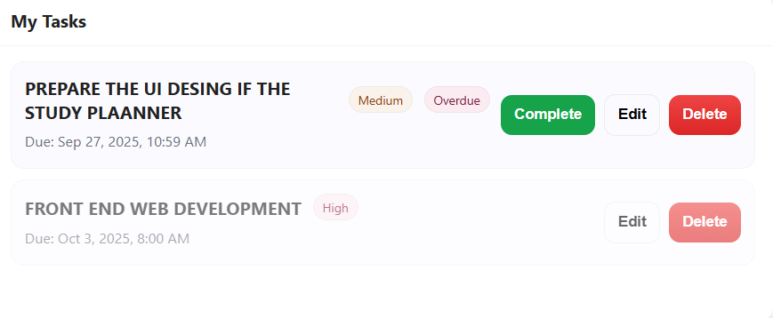

Slide 11
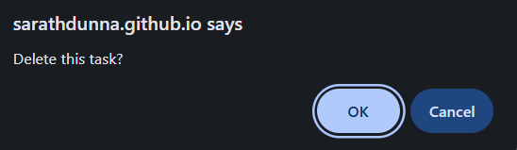

Slide 12
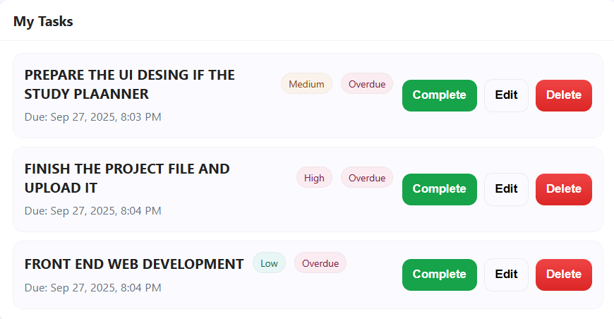

Slide 13
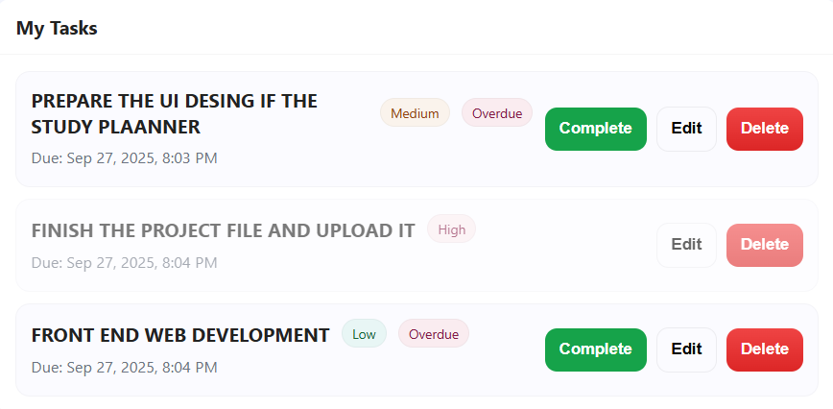

Slide 14
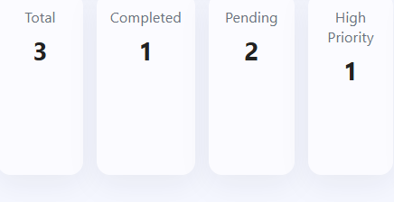

Slide 15
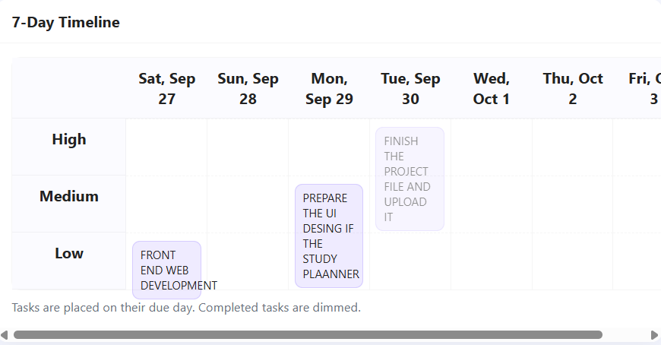

Slide 16
Conclusion
The Smart Study Planner enables students to effectively organize their tasks, set reminders, and track progress. It improves time management, reduces stress, and enhances academic productivity.

Slide 17
Future scope
AI-driven personalized study recommendations.
Cloud integration for cross-device access.
Mobile app version for on-the-go planning.
Collaborative features for group study and peer tracking

Slide 18


Reference
https://lsc.cornell.edu/how-to-study/studying-for-and-taking-exams/guidelines-for-creating-a-study-schedule/
http://learningcenter.unc.edu/tips-and-tools/studying-101-study-smarter-not-harder/

Slide 19
THANK YOU

